Slide 1
Data Solutions on Azure
Abdul Rasheed Feroz Khan
Microsoft MVP – Azure

Slide 2
Agenda
Overview of Azure.
Blob Storage.
Cosmos DB.
SQL Database.
SQL Data Warehouse.
File Sync.

Slide 3
Azure global infrastructure
50 Azure regions
Available in 140 countries
Up to 1.6 Pbps of bandwidth in a region
Scale globally
Reach more locations, faster, with the performance and reliability of a vast global infrastructure.
Safeguard data
Rely on industry-leading data security in the region and across our network.
Promote sustainability
Help build a clean-energy future and accelerate progress toward your sustainability goals.
Notes:
Azure Functions is actually built on top of the WebJobs SDK

Slide 4
Azure Datacenter
Opened first datacenter in 1989
Investment of more than $15 billion on infrastructure
Geo-replication over 500 miles apart
24x7 monitoring by US screened persons

Slide 5
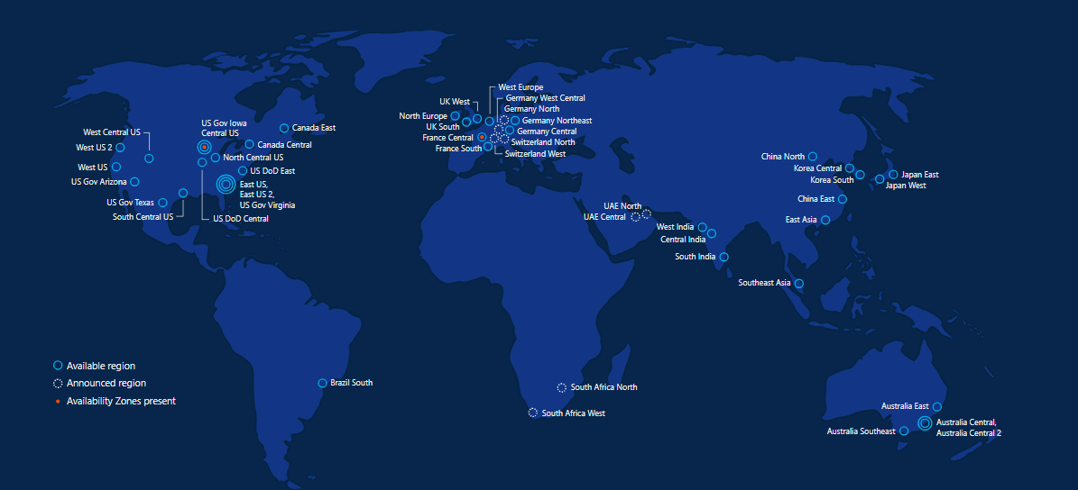
Azure regions – 50 Regions 140 Countries

Slide 6
Azure keep your data secure
Azure safeguards data in facilities that are protected by industry-leading physical security systems and are compliant with a comprehensive portfolio of standards and regulations.

Slide 7
Azure Developer Tools
Build apps that span IaaS and PaaS
Speed development of enterprise, web, mobile and IoT apps
Access the cloud directly from Visual Studio and other standalone and command-line tools
Build cloud apps for Java, Node, Python, Ruby, PHP, or .NET
Run Azure commands from your command-line interface
Diagnose live apps with world-class debuggers, profilers, diagnostic tools, and explorers

Slide 8
Azure Developer Tools
Visual Studio Tools for Azure
Azure SDK
Command Line tools
Azure PowerShell
Azure Command-Line Interface (Azure CLI)
PowerShell Tools for Visual Studio 2015
Storage Explorer
Visual Studio Code
Docker Tools
Azure Service Fabric Tools

Slide 9
Data Solutions on Azure

Slide 10
Azure Blob Storage
BLOB Storage – Binary Large Objects; any type of file or binary data; Storage for storing unstructured data. E.g., Documents, images, videos, logs files, VM Disks (vhd)
BLOB: https://accountname.blob.core.windows.net
Each BLOB can be of 100GB in size
Notes:
Selecting the right distribution method is key for good performance

Slide 11
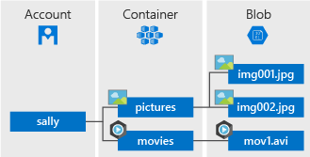
Azure Blob Storage
Notes:
Selecting the right distribution method is key for good performance

Slide 12
Storage Account
A unique namespace to store and access your Azure Storage data objects.
All objects in a storage account are billed together as a group.
By default, the data in your account is available only to you, the account owner.

Slide 13
Container
A container organizes a set of blobs, similar to a folder in a file system. All blobs reside within a container.
A storage account can contain an unlimited number of containers, and a container can store an unlimited number of blobs.
The container name must be lowercase.
BLOB name: MyNotes.txt
https://accountname.blob.core.windows.net/myContainer/MyNotes.txt

Slide 14
Blob
Azure Storage offers three types of blobs -- block blobs, append blobs, and page blobs (used for VHD files).
Page blobs
Used to store virtual hard disks optimized for random read/write operations
Block blobs
Used to store files like images and videos which are comprised of multiple blocks of data
Append blobs
Typically used with text files or log files where you append a line item to the end of a file. .

Slide 15
Tiers
Hot storage tier
optimized for storing data that is accessed frequently
Cool storage tier
optimized for storing data that is infrequently accessed and stored for at least 30 days.
Archive storage tier
optimized for storing data that is rarely accessed and stored for at least 180 days

Slide 16
Why choose Azure Blob Storage?
Strong consistency
When an object is changed, it is verified everywhere for superior data integrity, ensuring you always have access to the latest version.
Object mutability
Get the flexibility to perform edits in place, which can improve your application performance and reduce bandwidth consumption.
Multiple blob types
Block, page and append blobs give you maximum flexibility to optimise your storage to your needs.
Easy-to-use geo-redundancy
Automatically configure geo-replication options in a single menu, to easily empower enhanced global and local access and business continuity.

Slide 17
Use cases
Serving images or documents directly to a browser.
Storing files for distributed access.
Streaming video and audio.
Writing to log files.
Storing data for backup and restore, disaster recovery, and archiving.
Storing data for analysis by an on-premises or Azure-hosted service.

Slide 18
Pricing
Total cost of Block Blob storage depends on:
Volume of data stored per month.
Quantity and types of operations performed, along with any data transfer costs.
Data redundancy option selected.

Slide 19
CosmosDB

Slide 20
Azure Cosmos DB was built from the ground up with global distribution and horizontal scale at its core – it offers turn-key global distribution across any number of Azure regions by transparently scaling and replicating your data wherever your users are.

Slide 21
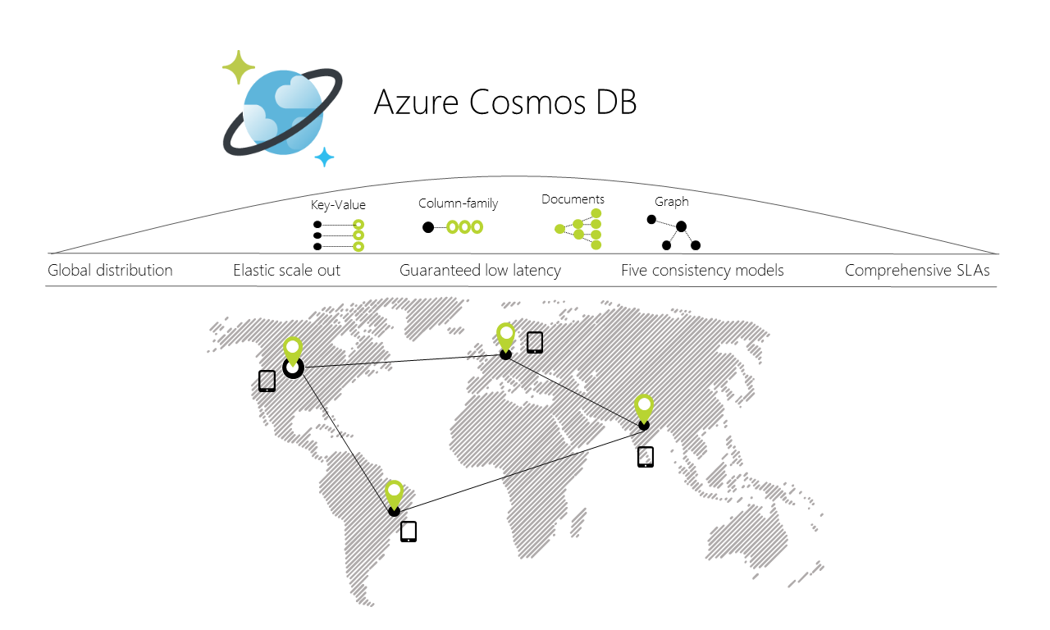
Azure Blob Storage
Notes:
Selecting the right distribution method is key for good performance

Slide 22
Global distribution
Easily build globally-distributed applications without the hassle of complex multiple-datacenter configurations.
Designed as a globally distributed database system
Automatically replicates all of your data to any number of regions of your choice, for fast, responsive access.
Supports transparent multi-homing and guarantees 99.99% high availability.

Slide 23
Multi-model + multi-API
Only Cosmos DB allows you to use key-value, graph, and document data in one service, at global scale and without worrying about schema or index management.
Cosmos DB automatically indexes all data
Allows you to use your favourite NoSQL API including SQL, JavaScript, Gremlin, MongoDB, and Azure Table storage to query your data.

Slide 24
Elastic scaleout of storage and throughput
Only pay for the throughput and storage you need.
Independently and elastically scale storage and throughput across one or multiple global regions.

Slide 25
Choice of consistency
Offers five well-defined consistency levels for an intuitive programming model with low latency and high availability for applications spanning the world.
Strong
bounded staleness
Session
consistent-prefix
eventual

Slide 26
Guaranteed single-digit millisecond latency
Serve read and write requests from the nearest region while simultaneously distributing data across the globe.
less than 10-ms latencies on reads writes at the 99th percentile.
less than 15-ms latencies on (indexed) writes at the 99th percentile.

Slide 27
Comprehensive SLAs
Rest assured your apps are running on world-class infrastructure, with “battle-tested” service, in the most trusted cloud.
Cosmos DB is the first and only service to offer industry-leading comprehensive 99.99% SLAs for latency at the 99th percentile, guaranteed throughput, consistency and high availability.

Slide 28
Capability comparison
Capabilities | Relational databases | Non-relational (NoSQL) databases | Azure Cosmos DB
Global distribution | No | No | Yes, turnkey distribution in 30+ regions, with multi-homing APIs
Horizontal scale | No | Yes | Yes, you can independently scale storage and throughput
Latency guarantees | No | Yes | Yes, 99% of reads in <10 ms and writes in <15 ms
High availability | No | Yes | Yes, Azure Cosmos DB is always on, has well-defined PACELC tradeoffs, and offers automatic and manual failover options
Data model + API | Relational + SQL | Multi-model + OSS API | Multi-model + SQL + OSS API (more coming soon)
SLAs | Yes | No | Yes, comprehensive SLAs for latency, throughput, consistency, availability

Slide 29
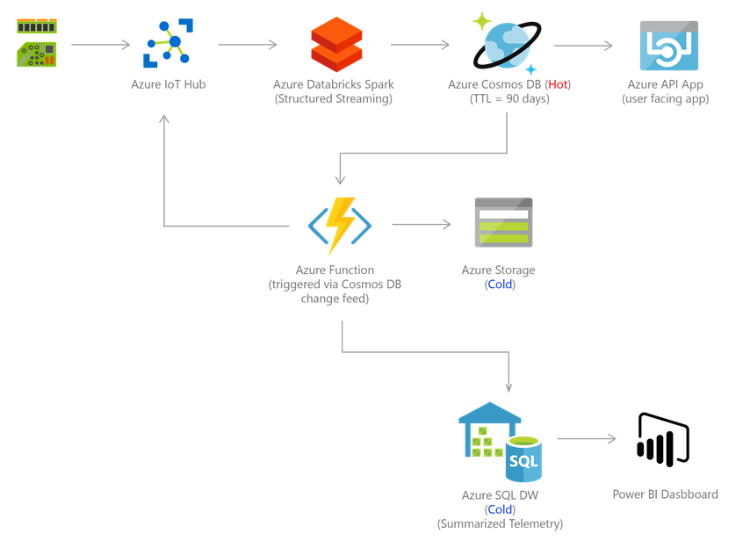
Use cases - IoT and telematics

Slide 30
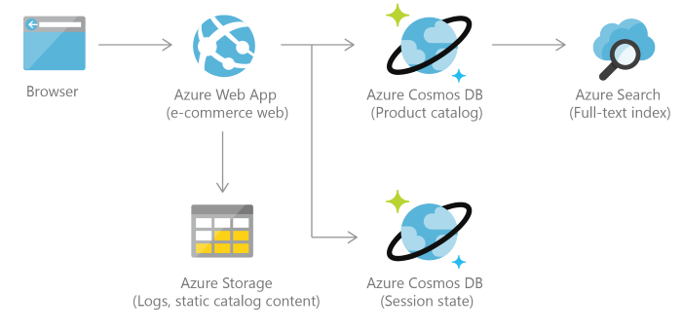
Use cases - Retail and marketing

Slide 31
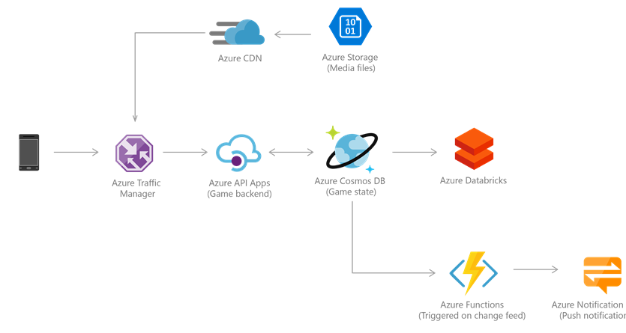
Use cases - Gaming

Slide 32
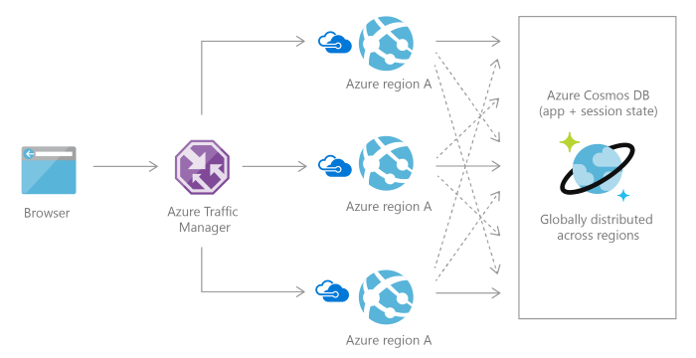
Use cases - Social Applications

Slide 33

Customers - NewOrbit
Needed extreme speed and scale for its new car-mileage-tracking app
Records for more than 6 million different cars
Contains JSON–based documents that list cars, inquiry history, mileage records, everyone who has previously owned a given car, and other details

Slide 34
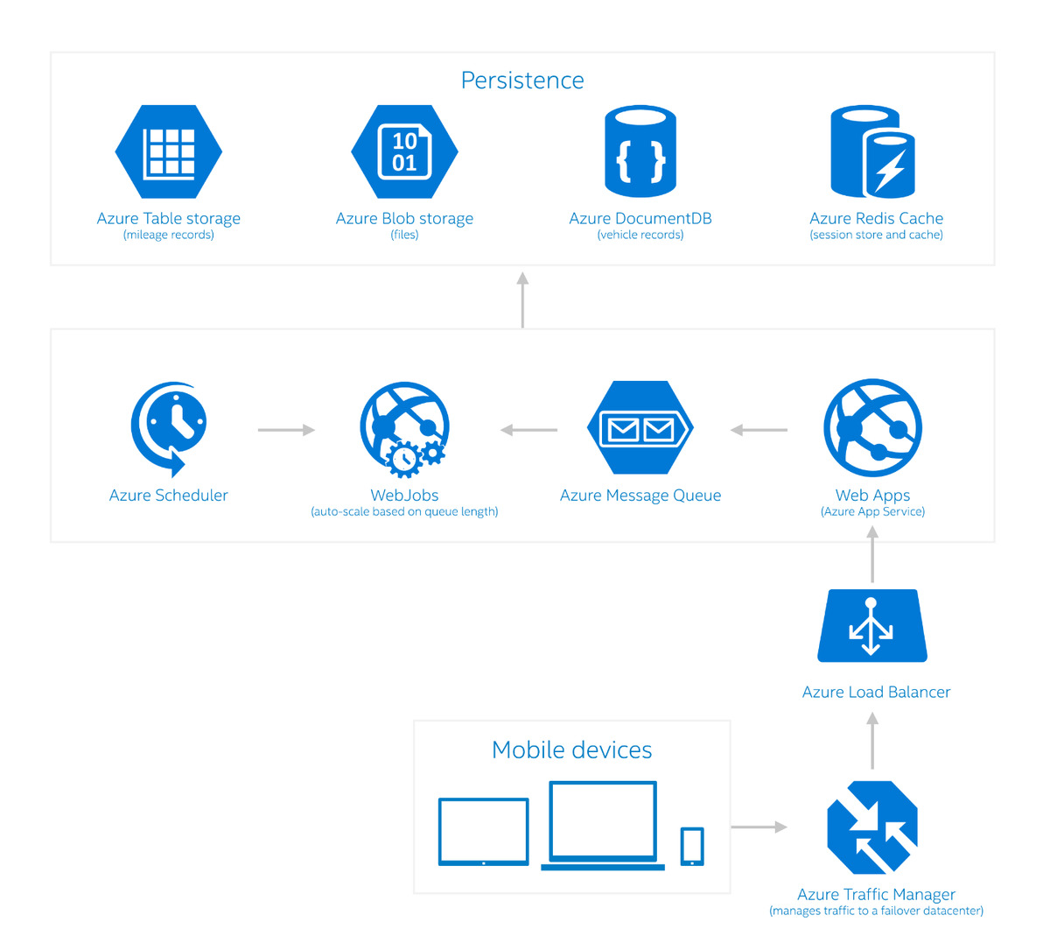
Customers - NewOrbit
DocumentDB enables the NewOrbit app to pull the entire record for a car in 100 milliseconds—all the way from the database through to the app’s JavaScript front-end.

Slide 35

Customers - Affinio
To analyse 50 million tweets per day
To manage more than 2.7 TB of active data
1 billion social-media profiles (adding 10 million per month)
User geo-location data
Data-mining results such of topic modelling links shared by social-media users

Slide 36
Customers - Affinio
The schema-free auto-indexing of all data fields that DocumentDB
The automatic data-partitioning capability
The virtually unlimited storage

Slide 37
SQL DB

Slide 38
Components of Azure SQL database
SQL Server.
SQL Database.
Server level Firewall.
Database level Firewall.
Tables.

Slide 39
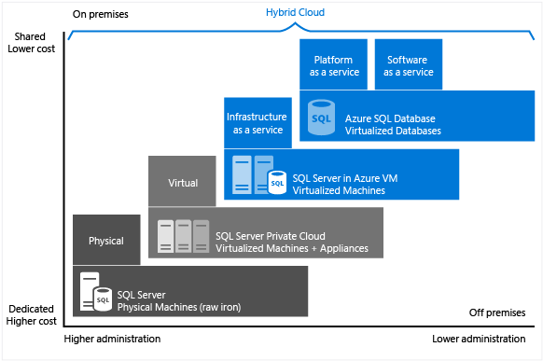
SQL Server IAAS & PAAS

Slide 40
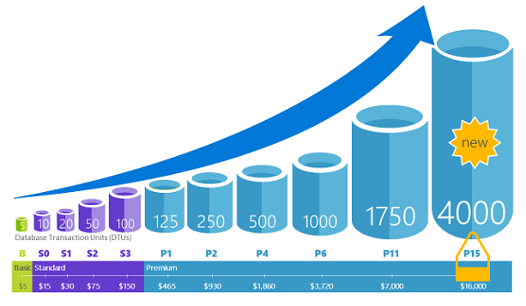
Performance and scaling

Slide 41
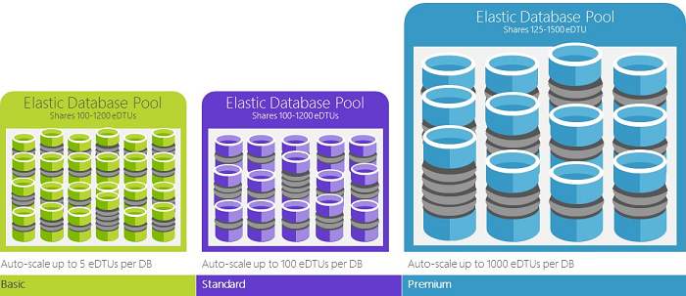
Elastic pool

Slide 42
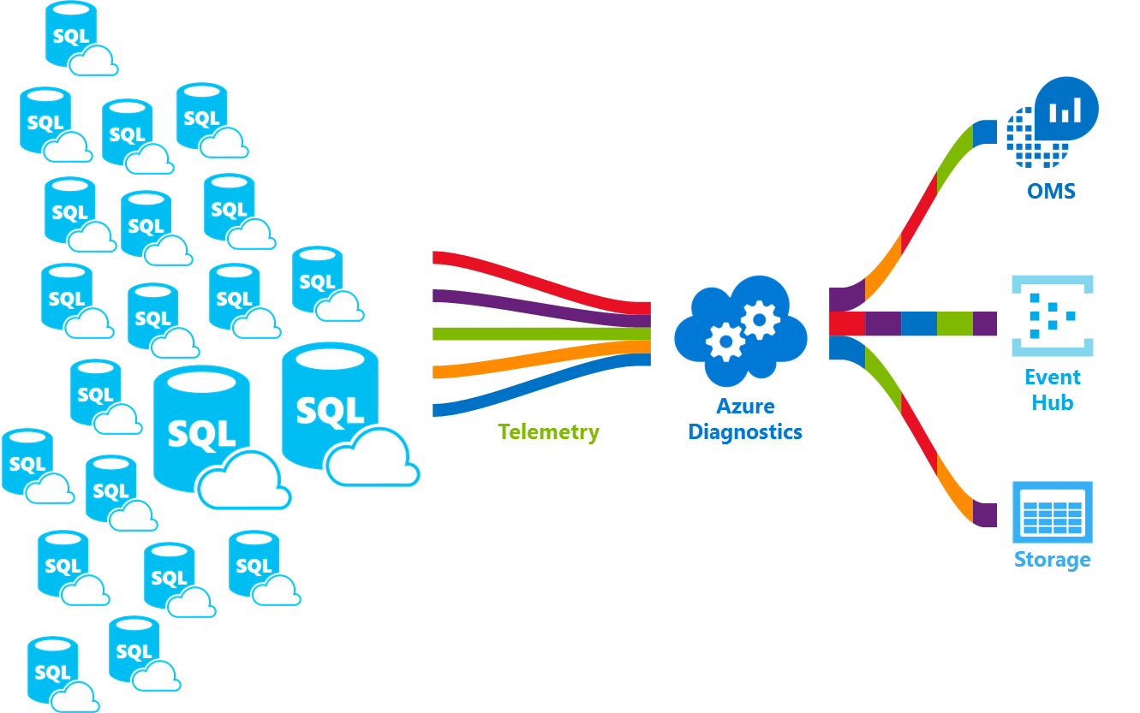
Monitoring

Slide 43
SQL Data Warehouse

Slide 44
A cloud-based Enterprise Data Warehouse (EDW) that leverages Massively Parallel Processing (MPP) to quickly run complex queries across petabytes of data

Slide 45
Azure SQL Data Warehouse
A Platform as a Service in Microsoft Azure cloud
It’s a Massively Parallel Processing system (MPP)
Distributed Compute and Distributed Storage
Scale up and down in couple minutes
Pause compute resources

Slide 46
Scale Up vs. Scale Out (SMP vs. MPP)
SMP - Symmetric Multiprocessing
Multiple CPUs used to complete individual processes simultaneously
All CPUs share the same memory, disks, and network controllers (scale-up)
All SQL Server implementations up until now have been SMP
MPP - Massively Parallel Processing
Uses many separate CPUs running in parallel to execute a single program
Shared Nothing: Each CPU has its own memory and disk (scale-out)
Segments communicate using high-speed network between nodes

Slide 47
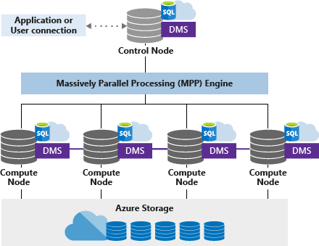
Architecture Azure SQL DW

Slide 48
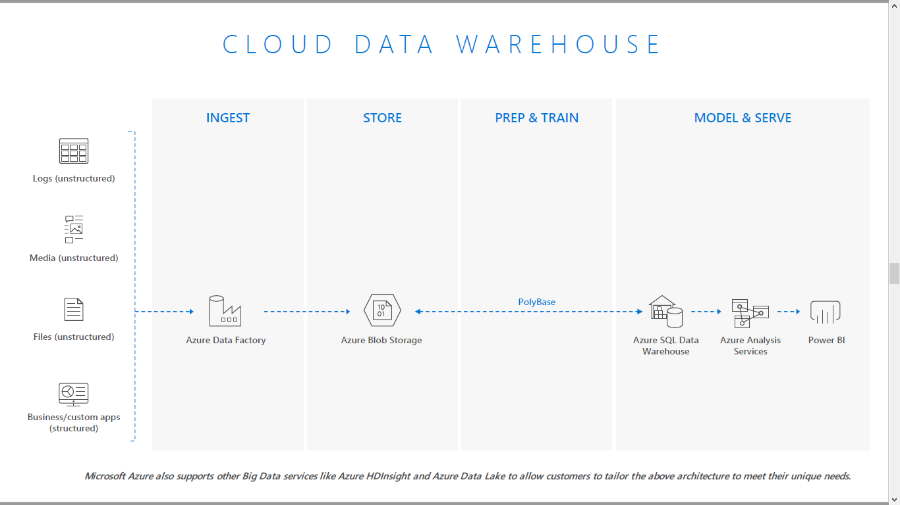

Slide 49
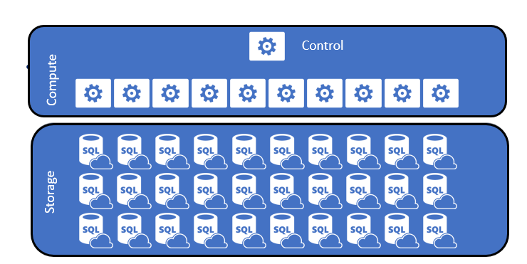
Logical Overview

Slide 50
Distributions
Distribution – SQL Database which stores one or more distributed table
Splits data table to 60 buckets through compute nodes
Hash distributed table
Round-Robin distributed table
Notes:
Selecting the right distribution method is key for good performance

Slide 51
Hash distributed
Data divided across nodes based on hashing algorithm
Same value will always hash to same distribution
Optimal for large fact tables
Data Skew can be an issue when distributing on high frequency values

Slide 52
Round-Robin distributed
Data distributed evenly across nodes
Easy place to start, don’t need to know anything about the data
Useful for dimension tables and tables without a good hash column
Will incur more data movement at query time

Slide 53
Data Warehouse Units (DWUs)
DWUs are measured of resources like CPU, Memory and IOPS, which are allocated to Azure SQL DW instance.
DWU 100 - 6000
How many compute nodes your instance uses
How many concurrent queries your instance can run.
How many parallel readers you can have for data loads
The size limit of transactions

Slide 54
Pricing
Compute - From $1.21/hour to $72.58/hour
Storage - $0.17/1TB/hour (Premium storage)
Data storage includes the size of your data warehouse and 7-days of incremental snapshot
Storage transactions are not billed
Geo-redundant copies is billed at Standard Disk RA-GRSs of $0.12/GB/month.

Slide 55
Azure SQL Data Warehouse
Scale and performance
Make data go further. SQL Data Warehouse gives you a cloud solution which removes limits to scale and performance. With tight Azure Databricks integration, bring together any data type at any scale.
Elastic and extensible
Optimise data warehouse performance and lower costs by scaling compute and storage independently. Pause your data warehouse to ensure you are only paying for the resources you need.
Trusted and secure
Count on enhanced security features and industry-leading compliance. SQL Data Warehouse is compliant across more than 50 certifications and available across global regions.
Seamless integration
Combine with leading data integration and BI solutions. SQL Data Warehouse is compatible across Microsoft and leading data integration and visualisation vendors such as Tableau and Informatica.

Slide 56
Service Capabilities
Limitless concurrency
Unleash the power of data with 128 concurrent queries and scale to unlimited queries with Azure Analysis Services integration.
Process any kind of data
Coupled with Azure Databricks and Azure HDInsight, easily connect and integrate your curated data into your data warehouse with PolyBase, giving you rapid intake from multiple data sources using the same query tooling experience.
Lightning-fast provisioning
Provision thousands of compute cores in under five minutes and scale to petabyte in hours.
Truly elastic by design
Independently and elastically scale compute and storage to adjust to your unique business needs.

Slide 57
Service Capabilities
Advanced security
Built-in features include Virtual Network service endpoints, advanced threat detection, always-on encryption, audit and simplified secure access through Azure Active Directory.
Fully managed infrastructure
Automatically provision infrastructure, optimisation and more, so that you can focus on driving value from your data.
Strong Ecosystem
Integration with leading data integration and visualization vendors and support from a large system integrator ecosystem to accelerate your time to value.
Industry leading SQL engine
SQL Data Warehouse is built on SQL Server, the industry’s top performing SQL engine, with the most comprehensive support for SQL language.

Slide 58
Service Capabilities
Industry-leading compliance
Protect and secure your data with more than 20 government and industry certifications, including HIPPA, to protect your data and keep it sovereign.
Global availability
The most geographically available data warehouse service in the cloud, available in more than 33 regions. Keep your data where your users are.

Slide 59





Customers

Slide 60
File Sync

Slide 61
Components of file sync
Storage Account.
Azure File Share.
Azure File Sync.
File Sync client.
Sync Group.
Cloud Endpoint.
Server Endpoint.

Slide 62
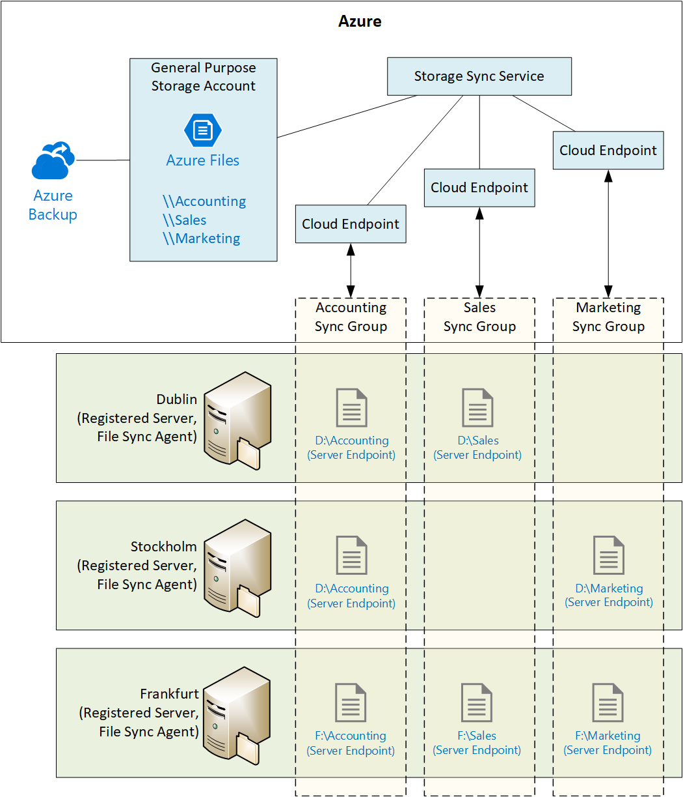
File Sync Architecture

Slide 63
Why Azure File Sync?
Transferring data into Azure.
Importing and Exporting data.
Cloning files into Azure.

Slide 64
Prerequisites for file sync
Storage Account.
Azure File Share.
Windows Server Machine.
File Sync Client.

Slide 65
Thank you

